Slide 1
Adiabatic switch circuit

Slide 2
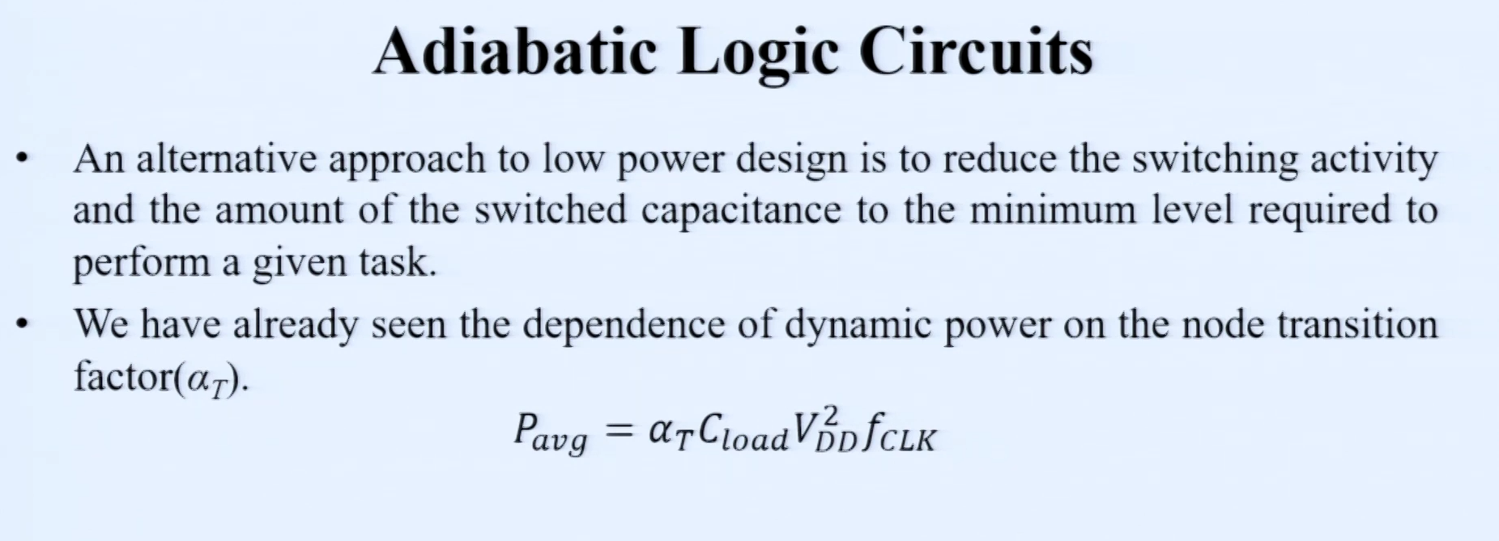

Slide 3
Adiabatic
Adiabatic circuits aim for energy-efficient switching.
They often use a gradual voltage ramp instead of abrupt switching.
Useful in low-power applications where energy efficiency is critical

Slide 4
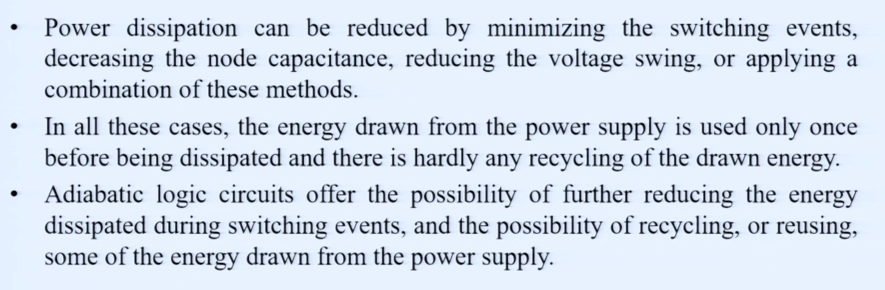

Slide 5
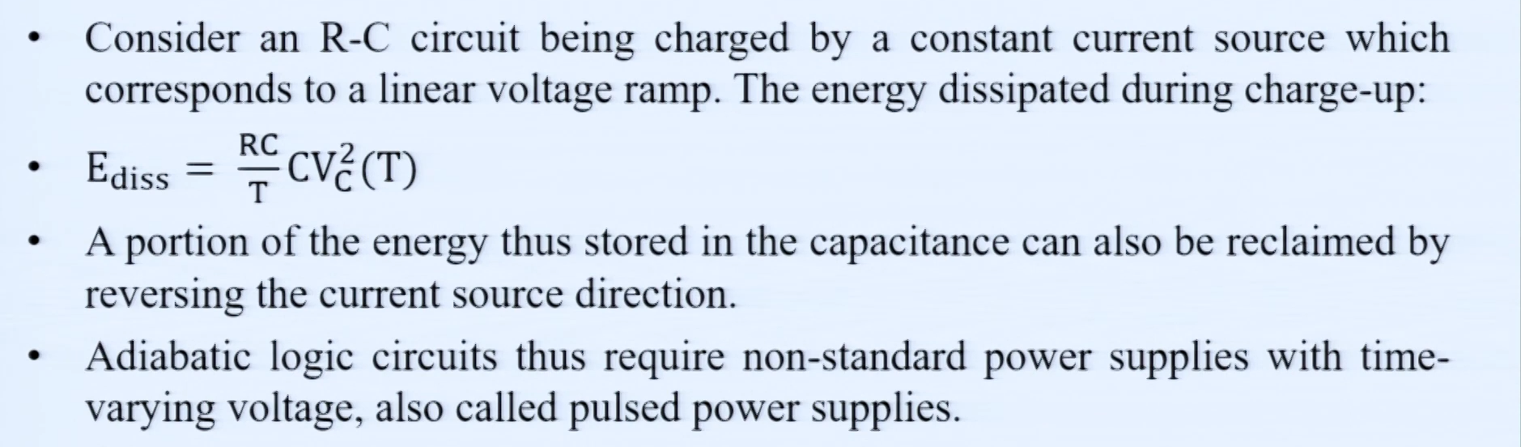

Slide 6
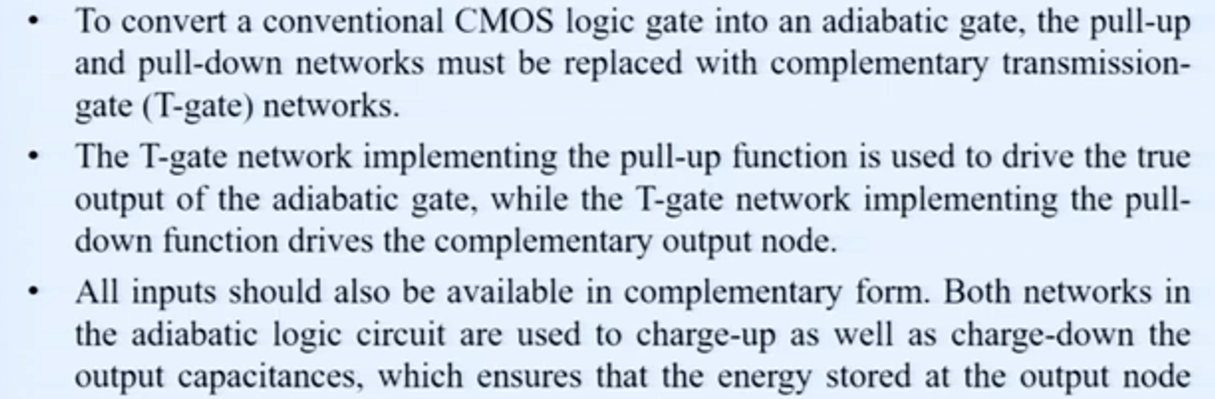

Slide 7
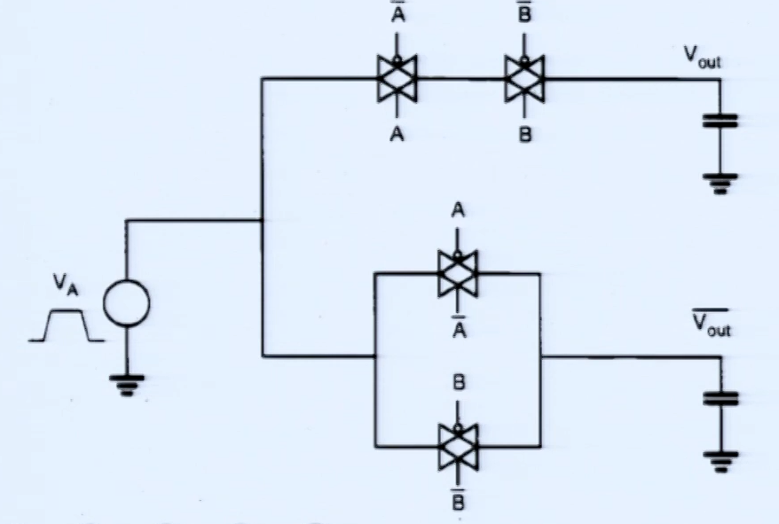
Adiabatic AND gate CMOS logic

